Slide 1

Docker(Dock worker) and Container
Nish Jha

Slide 2
Installer
Docker for Windows(64 bit)
on Hyper-VM
-Enable Hyper_V
Docker for Linux
You can use docker for Linux on docker for Windows.
Install for docker.com
Docker Install
Server Install
Cloud Install

Slide 3
Installer
Powershell/bash :
docker image
Install docker container
-

Slide 4
Bad Old days
Why docker
Container
Image
Docker for windows/Linux (HyperV)
Docker run hello-world
Python docker example
Python, node, .net docker example
Visual studio code Docker

Slide 5
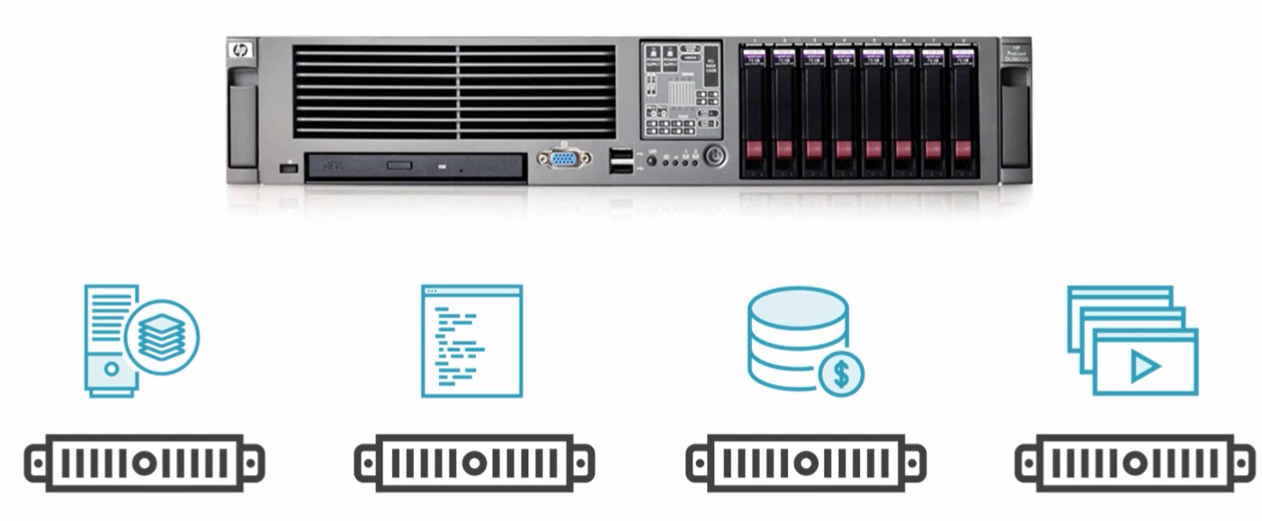
Bad Old Days

Slide 6
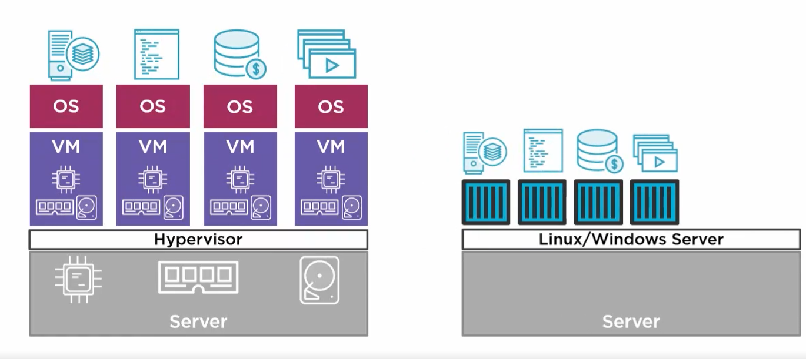
VM Ware vs Container

Slide 7
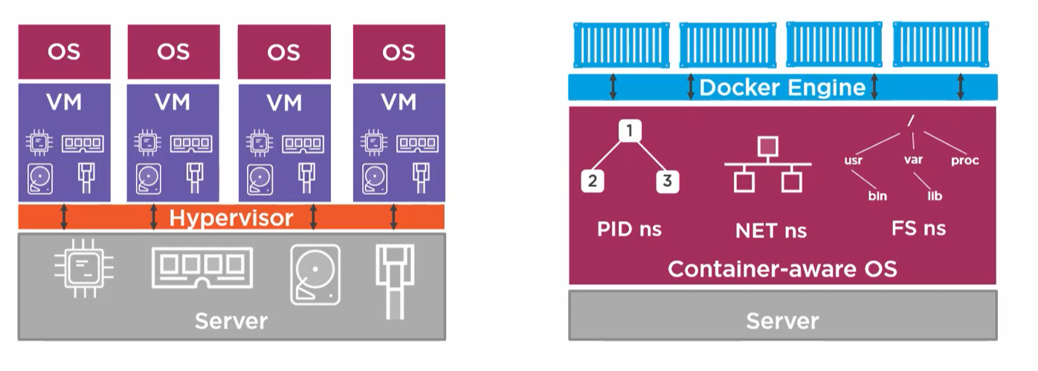

Setting up Morph

Slide 8
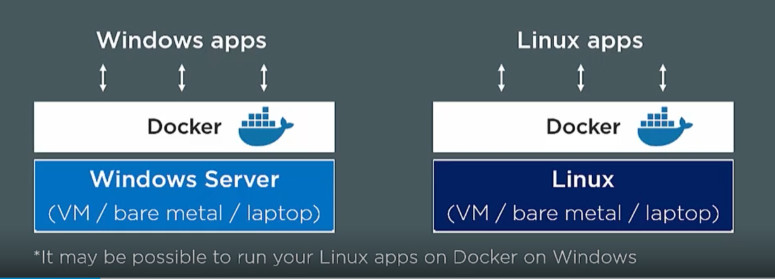

Slide 10


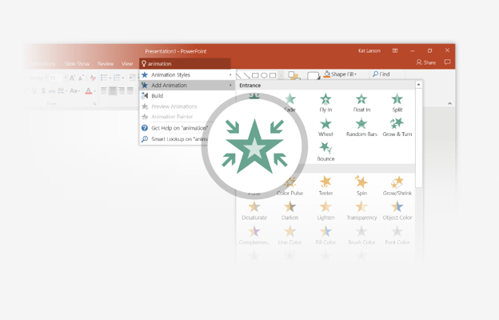
You’re an expert with Tell Me
The Tell Me box finds the right command when you need it, so you can save time and focus on your work. Try it:
SELECT ME
1
Select the Robot picture on the right.
2
Type animation in the Tell Me box, and then choose Add Animation.
3
Choose an animation effect, like Zoom, and watch what happens.

Slide 11
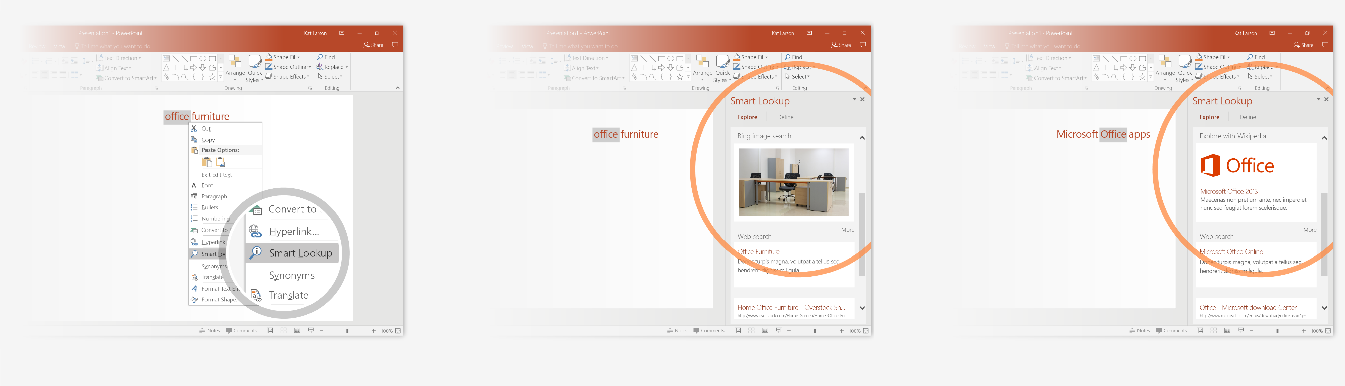
Explore without leaving your slides
Smart Lookup brings research directly in to PowerPoint. Try it:
1
Right-click in the word office in the following phrase: office furniture
2
Choose Smart Lookup, and notice that results are contextual for that phrase, not Microsoft Office apps.
3
Just for fun, try Smart Lookup again by right-clicking in the word Office in Step 2.

Slide 12

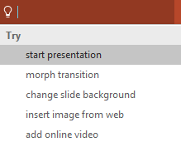

More questions about PowerPoint?
Select the Tell Me button and type what you want to know.
Visit the PowerPoint team blog
Go to free PowerPoint training
Give feedback about this tour
SELECT THE ARROW WHEN IN SLIDE SHOW MODE
Notes:
In Slide Show mode, select the arrows to visit links.

